Slide 1


EV Car Web Application
Your ICT and Digital Transformation Solutions Provider
System Development Cost Proposal

Slide 2
Our Company
We are system integration and software development company that provide ICT solution based on what our customer needs. We develop and customize enterprise software applications to resolve your operation issue, deliver the reliable system on time and implement the best value IT solution for our customers. Our project consultants and software engineers have more than 7 years of experiences in enterprise and mobile app implementation for SME and corporate customers.

Slide 3
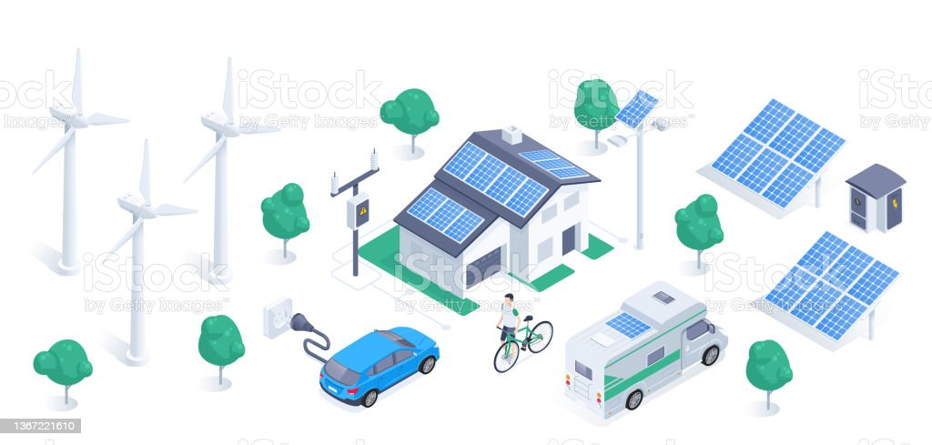
The Big Idea
The objective of the project is to develop a mobile and web portal to book test drive, buy EV Car, and apply for loan online.
To create best route planner

Slide 4

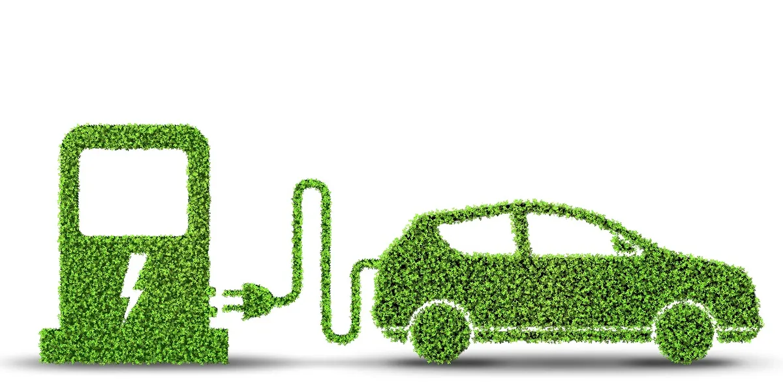
Problems & Solution
Current Problem
Many people are facing increasing pressure to reduce the carbon footprint from the global landscape for maintaining an environment clean and fresh.
Business owners who are involved in providing eco green services those have a great opportunity to launch their venture website over the web.
Proposed Solution
This proposed application will help you launching your electric car and charging stations website can encourage lots of people in making environment healthy.

Slide 5
Deliverables
Web Portal for Customers
Mobile Application for Customers
Admin Backend System

Slide 6
Project Scope
Overview
To create benchmark to charge EV app
To develop jom charge application
To develop route planner
Backend
Super Admin will login to the dashboard with the credentials provided.
Admin will display a list of admin details
Branch Account Dashboard will display a list of branch account details
User Types
Different types of user levels:
Super admin who will manage everything.
Admin will handled loan
Customer will register and download the app and use website

Slide 7
Phase 1
Phase 2
Phase 3
Modules and Functions
Website
Promote new EV Car brand
Corporate Information
Ecommerce for EV Car
Benchmark to ChargeEV App
Book Car
Book car for test drive
Functions
Charge Station Map
Pay Charging Station
See Car Status
Car has esim with interval to update car status
User Driving Pattern, Records, Analysis
Car Usage Analysis, Location History
Any Car use this app to pay charging station (not only client EV Brand)
Buy Car
Pay car deposit
Full payment with loan
Car Loan
Apply Loan
Banker Approve Loan
Handle by Backend Admin
Customer Service
Explain all issues
FAQ
Car Maintenance Service online
Book Maintenance Service
Less Maintenance need

Slide 8
Main Features
Promote EV car brand
E-commerce for EV car
Customer Service
Benchmark to charge EV app
Charge Station Map
Pay Charging station
Track car Status
Analyse: Driving pattern, Records
Analyse: Car usage, location history
Car Loan
Car maintenance Service
Book Car
Buy Car
Plug share
Better Route Planner
No Downtime on charging app to control payment

Slide 9
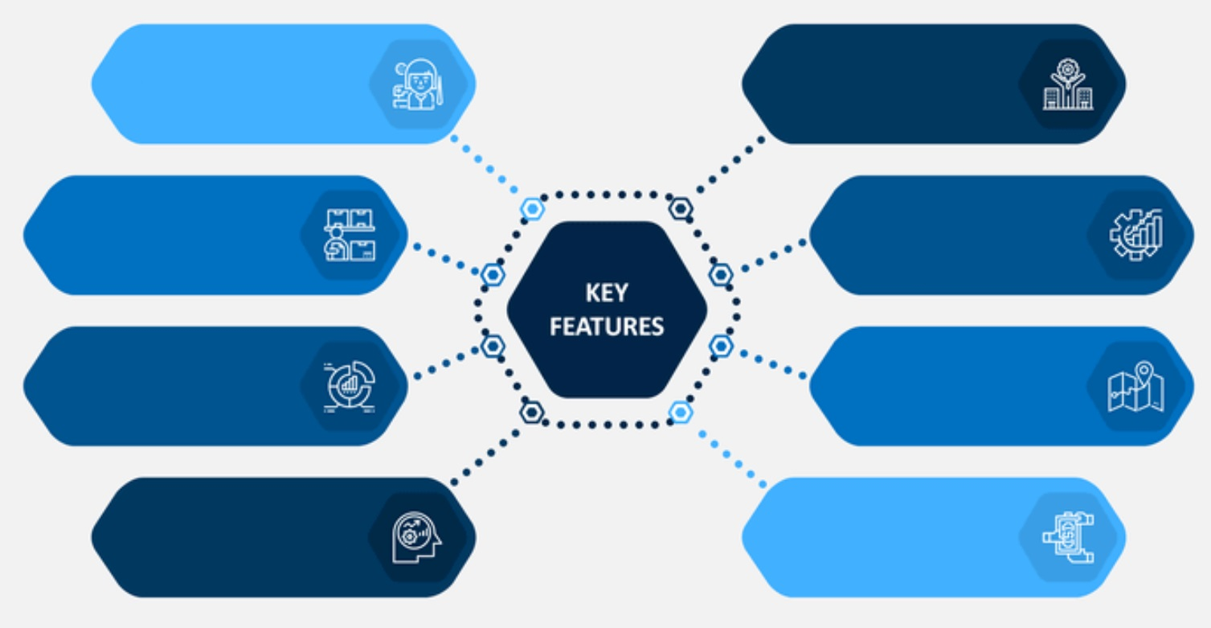
Key Features
Mobile friendly
Book car for test drive
Esim to update car status
Pay Car Deposit
Other car can use app to
pay EV app
Apply Loan
24 hours / 365 days
maintenance
Book Maintenance Services

Slide 10
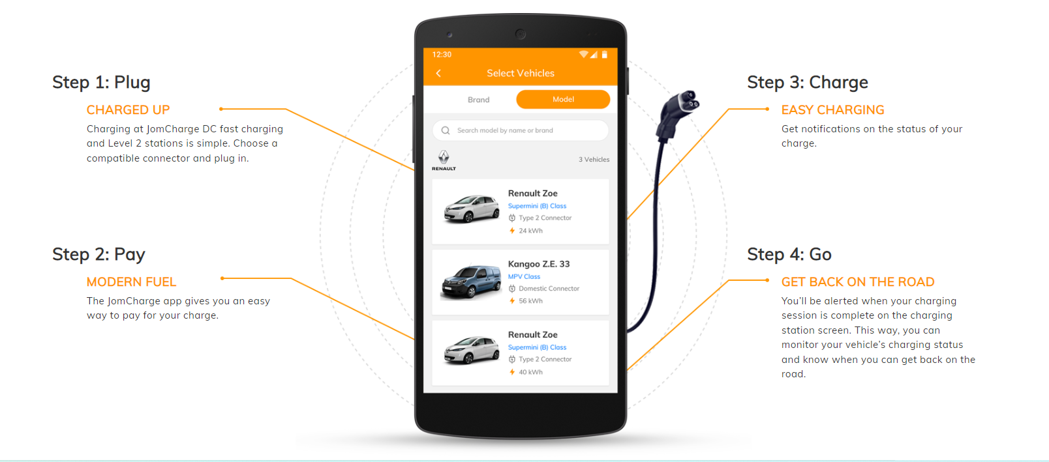
EV Charge App – How it works

Slide 11
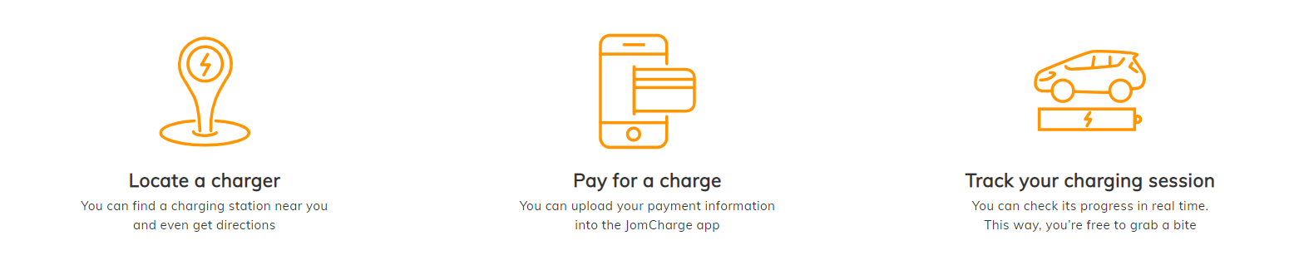
EV Charge App

Slide 12
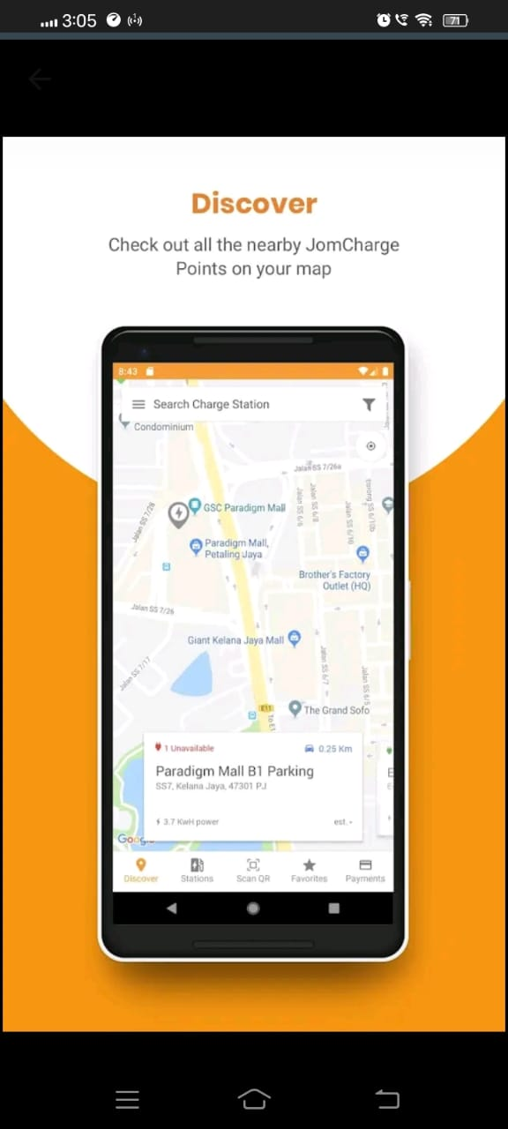
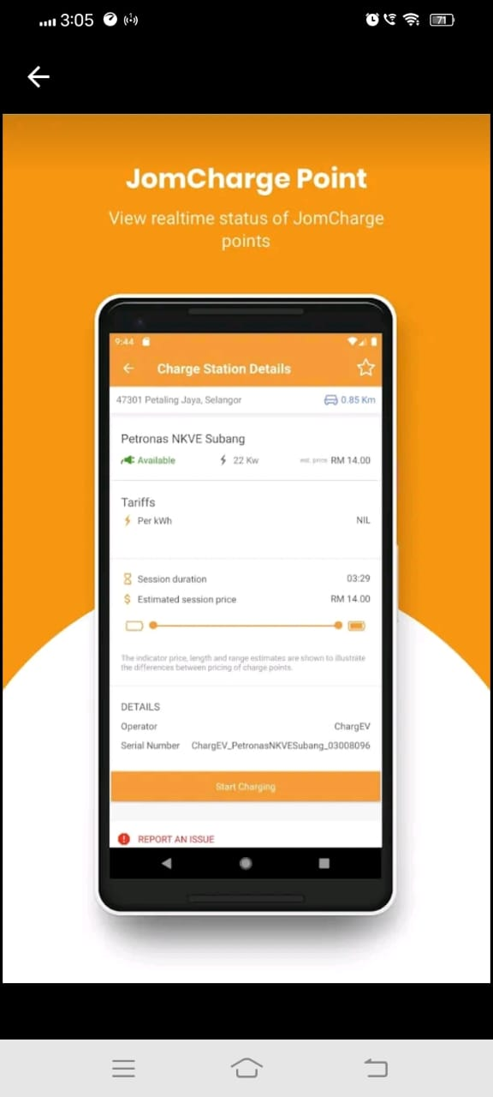
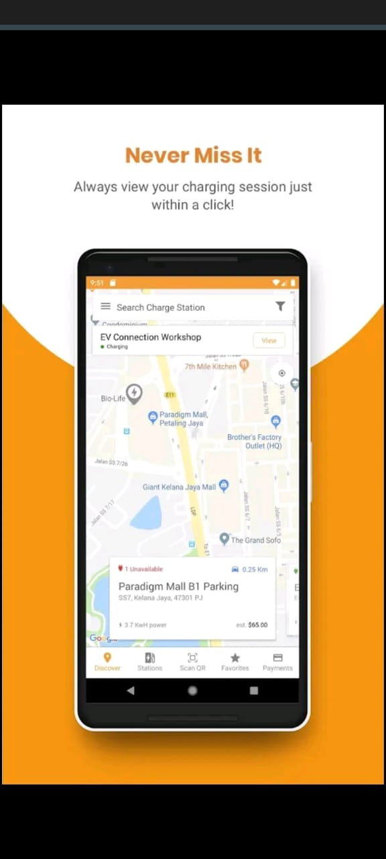
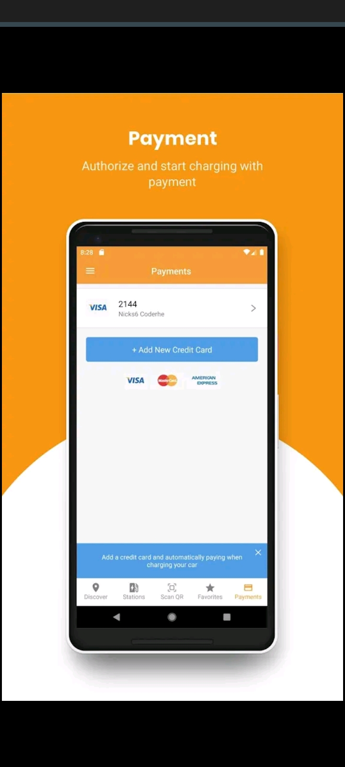
EV Charge App

Slide 13
User
Find list of plug share centers
Check cost
Plugs
Check parking
Check Hours
Check Amentities
Dining
Shopping
Grocery
Park
Restrooms
List of cars
Plugshare App Flow

Slide 14
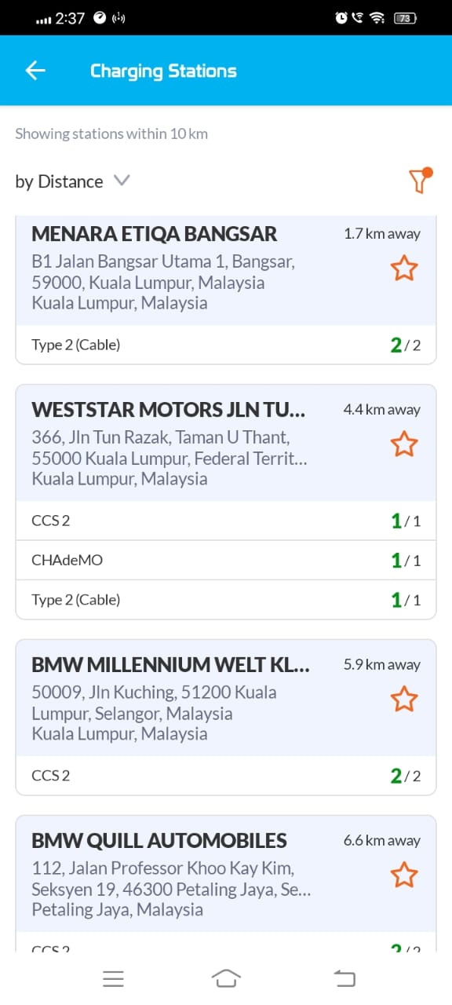
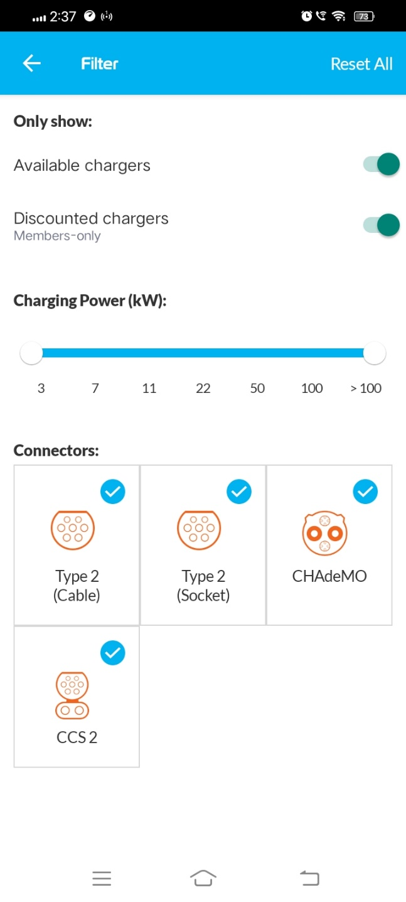
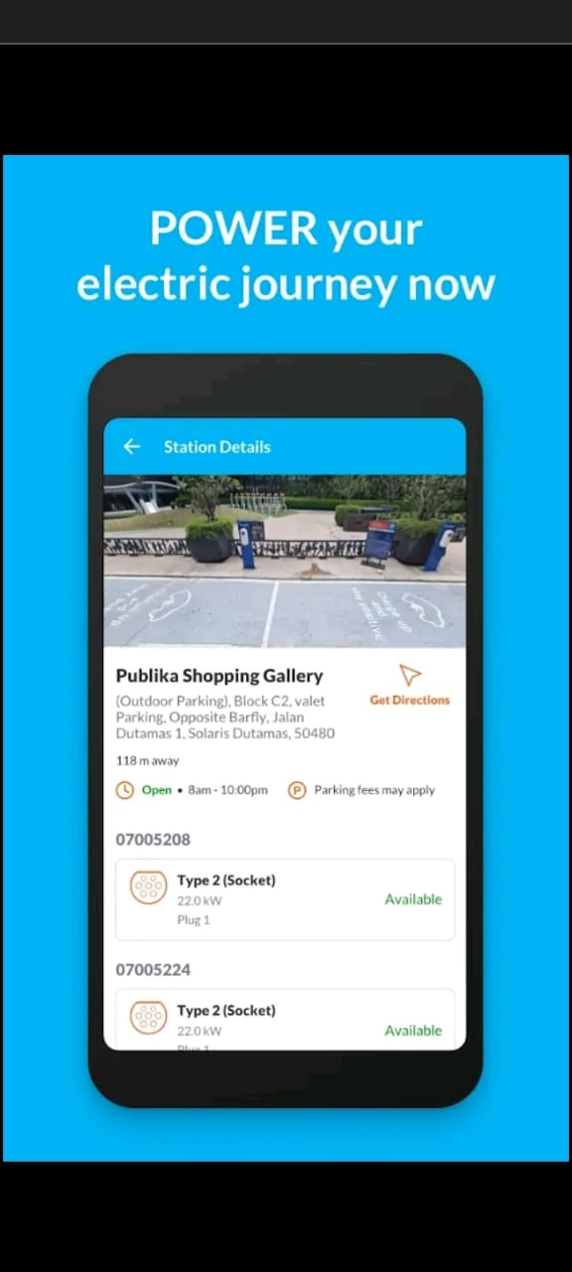
Plug Share Finding

Slide 15
Plugshare Key Features
Share electricity from home EV plug or domestic outlet with other EV owners
Contact PlugShare members via app, phone or SMS to coordinate charging at a shared residential charger
Check-in, review, add tips and photos about charging location experience
Plan trips and get directions to outlets or charging stations via Google Maps, Apple Maps, and Waze
Share charging station links using Facebook, LinkedIn, or Twitter
Get notifications when a new charging station is installed nearby

Slide 16
Work Breakdown Structure
Requirement Gathering and Documentation
UI Graphic Design
UI Implementation
Phase 1
Customer Application System Requirements
Logging
E-mail sign in / sign up
Forgot password
Website
Promote new EV car brand
Corporate Information
Phase 2
Ecommerce for EV Car
Book Car
Book car for test drive
Buy Car
Pay car deposit
Full payment with loan
Car Loan
Apply Loan
Banker Apply Loan
Manually handled by backend admin
Customer Service
Able to explain all issues
FAQ about the Car online
Car Maintenance Services Online
Book maintenance services
EV Car very little maintenance need

Slide 17
Work Breakdown Structure
Phase 3
Benchmark to ChargeEV App
Functions
Charge station map
Route Optimization
Pay charging station
See Car status
Car has esim with interval to update Car status
Analyze User Driving pattern
Driving records analysis
Car usage analysis
Location history, etc
Any car also can use this app to pay charging station, not only client EV Brand
Test
UAT
Build Release

Slide 18
Technology Stack
Description | Technology
Backend Programming language | PHP
Framework | Laravel
Database | MariaDB
Frontend | HTML5, CSS3, JavaScript, JQuery
Mobile App | Native Mobile App
Operating System | Android & iOS

Slide 19
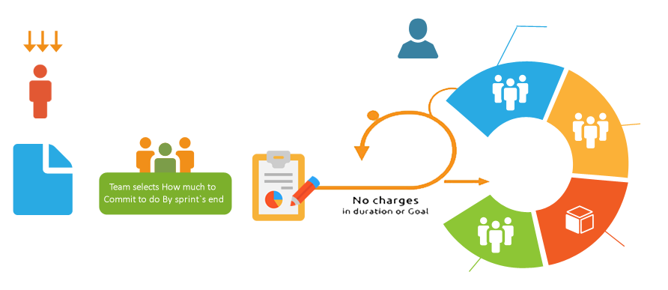








Our Development Strategy
We are specialised in Agile Scrum/XP
Daily Scrum Meeting &
Artifacts Update
Input from End-Users, Customers,
Team and Other Stackholders
SCRUM MASTER
Team
Review
PRODUCT OWNER
Sprint
1-4 weeks
Product
Backlog
Sprint Planning Meeting
(Parts One and Two)
Potentially
Shippable Product
Increment
Retrospective

Slide 20



Resource Plan
OFFSHORE TEAM
Team Member Role | FTE
Project Manager | 1
Business Analyst | 1
System Architect | 1
Web Developer | 1
Mobile Developer | 1
Test Engineers | 1
PROJECT
MANAGER
BUSINESS ANALYST
System Architect
MOBILE DEVELOPER
WEB DEVELOPER
TEST ENGINEER

Slide 21
Approximate Timeframe – Phase 1
Requirement Gathering, Analysis & Documentation
Weeks
01-02
Design and Development Completion
Weeks
03-04
UAT Release, Sign off & Deployment
Weeks
05-06
Note:
We will be sharing regular build hosted in our server, from Month 2 onwards
The given project delivery plan is based on our regular resource planning. In case of any deadline we can tweak the plan based on mutual consent.

Slide 22
Approximate Timeframe – Phase 2
Requirement Gathering, Analysis & Documentation
Weeks
06-07
Design and Development Completion
Weeks
08-11
UAT Release, Sign off & Deployment
Weeks
12-14
Note:
We will be sharing regular build hosted in our server, from Month 2 onwards
The given project delivery plan is based on our regular resource planning. In case of any deadline we can tweak the plan based on mutual consent.

Slide 23
Approximate Timeframe – Phase 3
Requirement Gathering, Analysis & Documentation
Weeks
15-16
Design and Development Completion
Weeks
17-22
UAT Release, Sign off & Deployment
Weeks
23-24
Note:
We will be sharing regular build hosted in our server, from Month 2 onwards
The given project delivery plan is based on our regular resource planning. In case of any deadline we can tweak the plan based on mutual consent.

Slide 24
Cost
Description | Cost(RM)
Corporate Website | 16,000
Ecommerce Portal Admin Backend System | 42,000
Mobile App for Customer (EV charging App) | 52,000
Total | 110,000

Slide 25
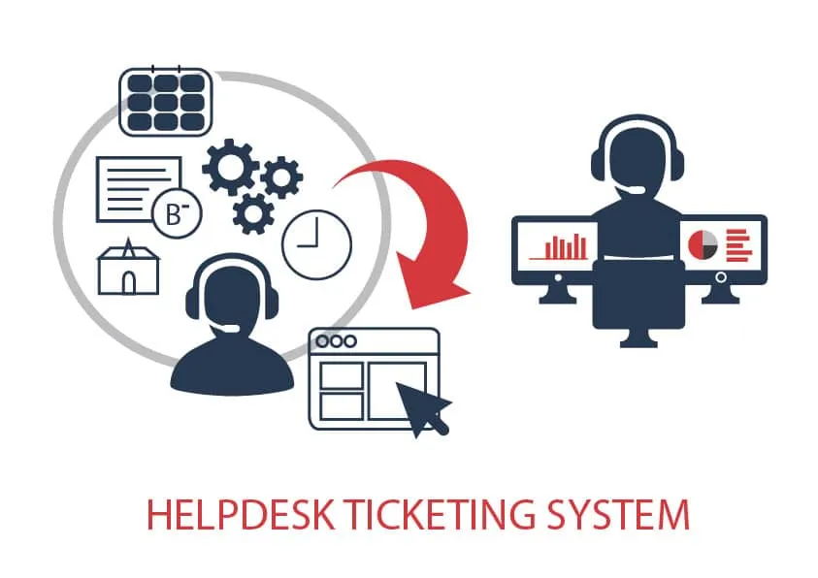
Ticketing System
Ticketing system helps your customers to engage with you on their own terms.
Ticketing system handles context of what issue the customer is facing, along with other details like category, priority, etc.
Ticket system also helps you to grow with your customers support.
Customers can submit for warranty, upload picture.
Submit any complaint for support needed.
Reply mail needs to send to customers.
Customer can choose preferred contact channel like email or call or chat via helpline, that will remark to ticket team.

Slide 26

Features of Ticketing System
Multichannel Ticketing - This is a system that allows customer support through multiple platforms.
Customization - Businesses should be keen to provide services that match their themes and brand voice since this is what the customers expect.
Automation - An automated system is effective because it reduces costs and time. It is effective and generally provides a good quality help desk
Self Service - A good help desk provides answers to queries before they are even asked. Sections like blogs, informatics, and FAQs (frequently asked questions) are essential to any ticketing software.

Slide 27
Assumption
The project will be hosted in client provided server after the UAT.
The estimate covers the efforts for developing functionalities mentioned in Work Breakdown Structure section.
The estimates are based on requirement shared by the client.
We assume that the stakeholders will be available for clarifications and support throughout the project time frame
All contents will be provided client.
Source codes will release to client upon full payment made
Web hosting for production and beta testing will be provided by client

Slide 28
THANK YOU
Please feel free to contact us if you need further clarification or information.
We will be happy to assist you.
https://techstar.my
Contact: Ray Low 017-3102898
raylow.biz@gmail.com / ray@techstar.my

